Slide 1
Diabetes Prediction
Evan Gousha and Gabe Migliore

Slide 2
Introduction
Diabetes can be developed genetically or from certain behaviors.
forms when insulin doesn’t exist in your bloodstream, or the insulin is unable to bind with cells
Our datasheet looks into whether patients have undiagnosed diabetes

Slide 3
Background-Variables
Pregnancies
Glucose
Blood Pressure
Skin Thickness
Insulin
BMI
Diabetes Pedigree Function
Age
Outcome

Slide 4
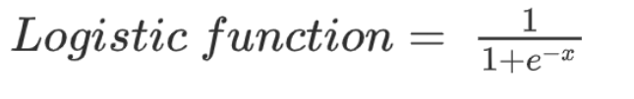
Background-Machine Learning
Logistic Regression
a process of modeling the probability of a discrete outcome given an input variable. The most common logistic regression models a binary outcome; something that can take two values such as true/false, yes/no, and so on.

Slide 5
Exploratory Analysis
Medium Sized dataset
8 columns, 7 independent variables, 1 dependent variable
768 entries per column

Slide 6
Data Preparation
Not much preparation was needed
None of the columns contained null values
None of the variables were categorical

Slide 7
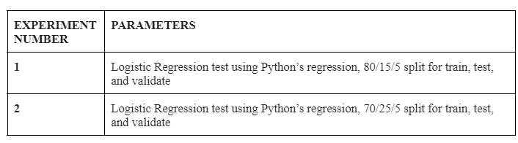
Experimental Design
Sample of 5 used to validate, randomly selected using data.sample

Slide 8
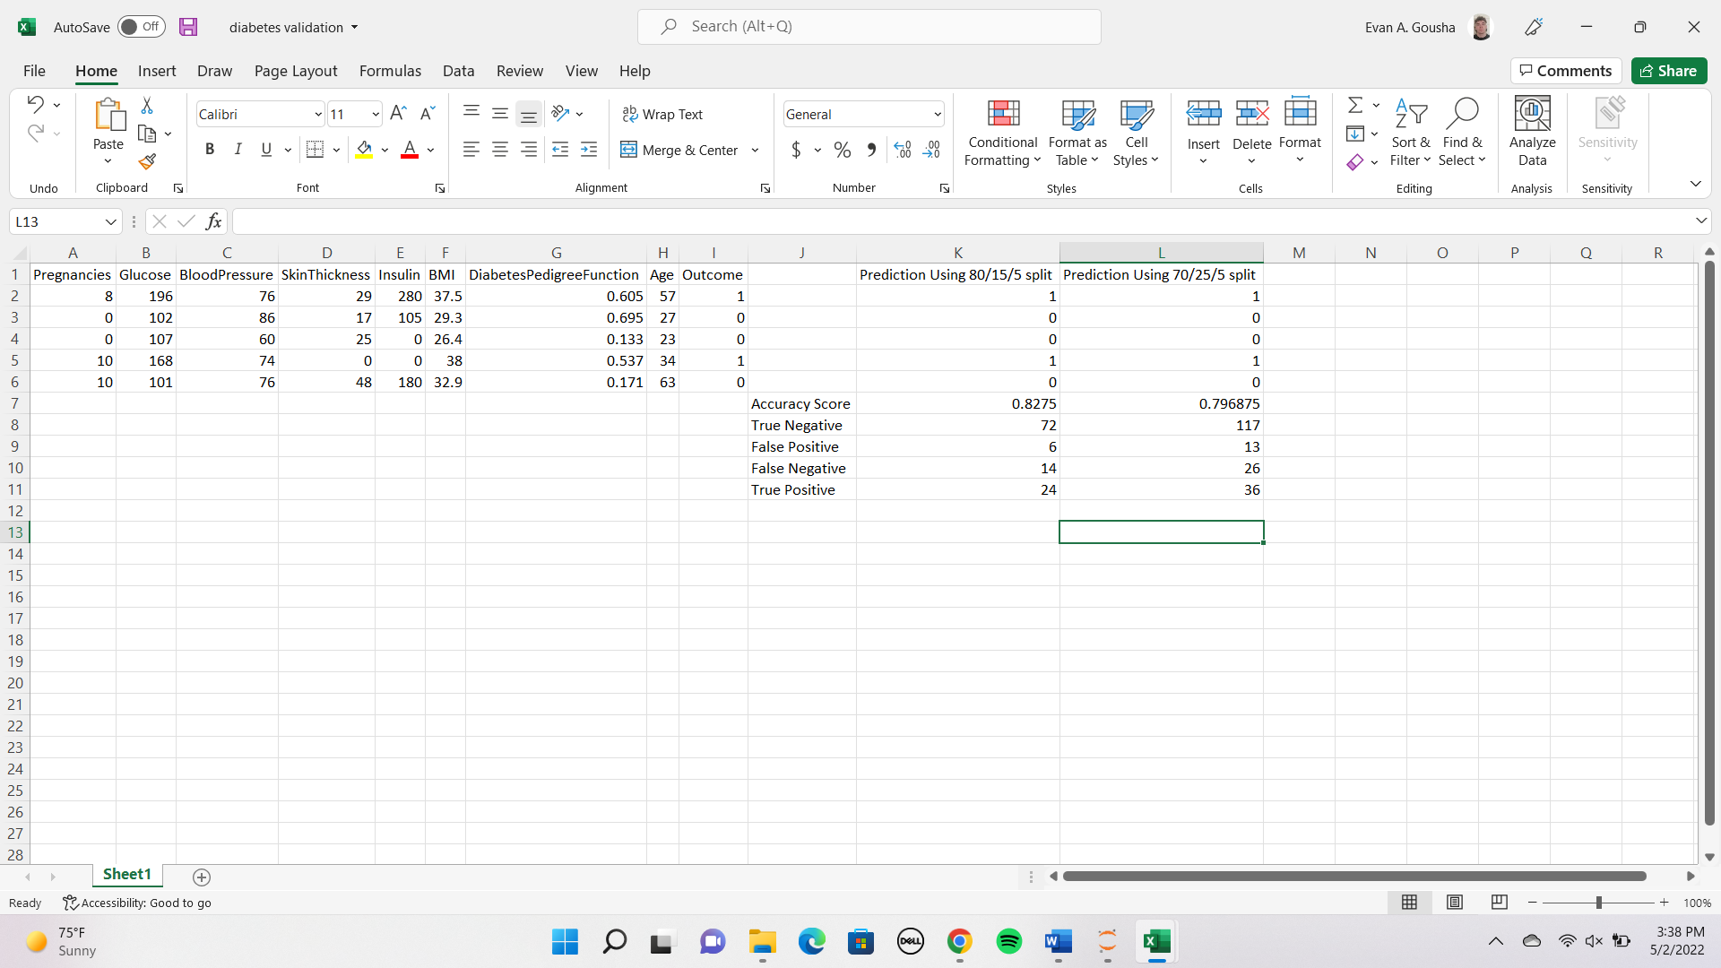
Results-Validation

Slide 9
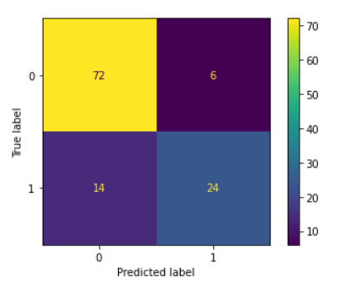
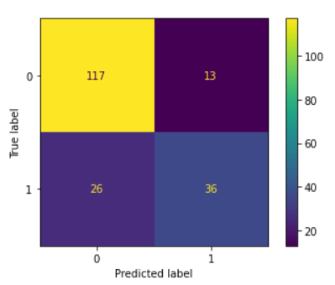
Results-Confusion Matrices
80/15/5 Split 70/25/5 Split

Slide 10
Results-Discussion
Both models were relatively accurate
80/15/5 split had a higher accuracy score of 0.8275
Also had fewer false negatives which are important when looking at medical data

Slide 11
Problems Encountered
No major coding errors were faced
Only problem was trying to find out exactly what all the variables meant
This meant learning medical terminology

Slide 12
Limitations
Given the medical nature of this data, the implementation of the model is not necessarily realistic
More investigation needs to be done to really say anything for certain
We aren’t doctors

Slide 13
Improvement/Future?
Best way to improve results would be to perform more tests
Perhaps using even more different split size
Perhaps using other models
Also, learn medical terminology

Slide 14
Conclusion
We used two different Logistic Regression models
80/15/5 split model proved to be the more accurate
Considering the type of data, more tests and models would be necessary to make any serious claims, but models still provided some reasonable insight

